Slide 1

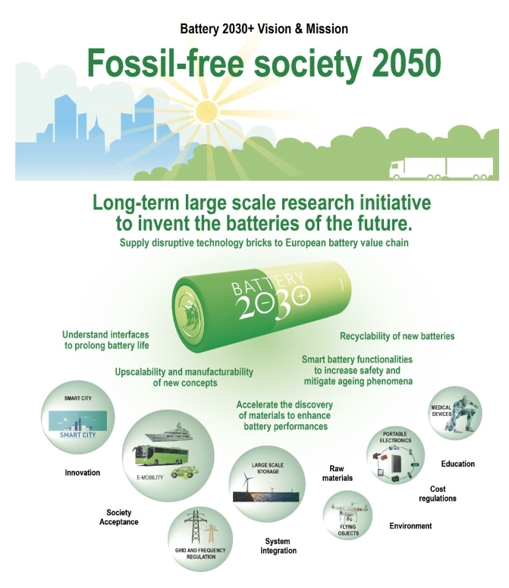







Roadmaps
Kristina Edström
Department of Chemistry – Angstrom Laboratory, Uppsala University, Box 531, 751 21 Uppsala, Sweden

Slide 2
800 GWh/year battery cell production in Europe in 2030
ENVIRONMENTAL IMPACT
50 kWh per EV ➔ 16 million EV/year
(≈ passenger car registrations in the EU)
ECONOMIC IMPACT
Battery pack 70 €/kWh ➔ 56 B€/year market¹
SOCIETAL IMPACT
250 jobs/GWh ➔ 200,000 jobs²
Battery cell production capacity and demand in Europe (GWh/year)
Notes: ¹Market at battery pack level; ²Direct and indirect jobs in the battery value chain from materials, cells to packs (incl. machinery and equipments).
Sources: Fraunhofer ISI, Future expert needs in the battery sector (2021); ACEA, The automobile industry pocket guide (2020); EUCAR, Battery requirements for future automotive applications (2019).

Slide 3
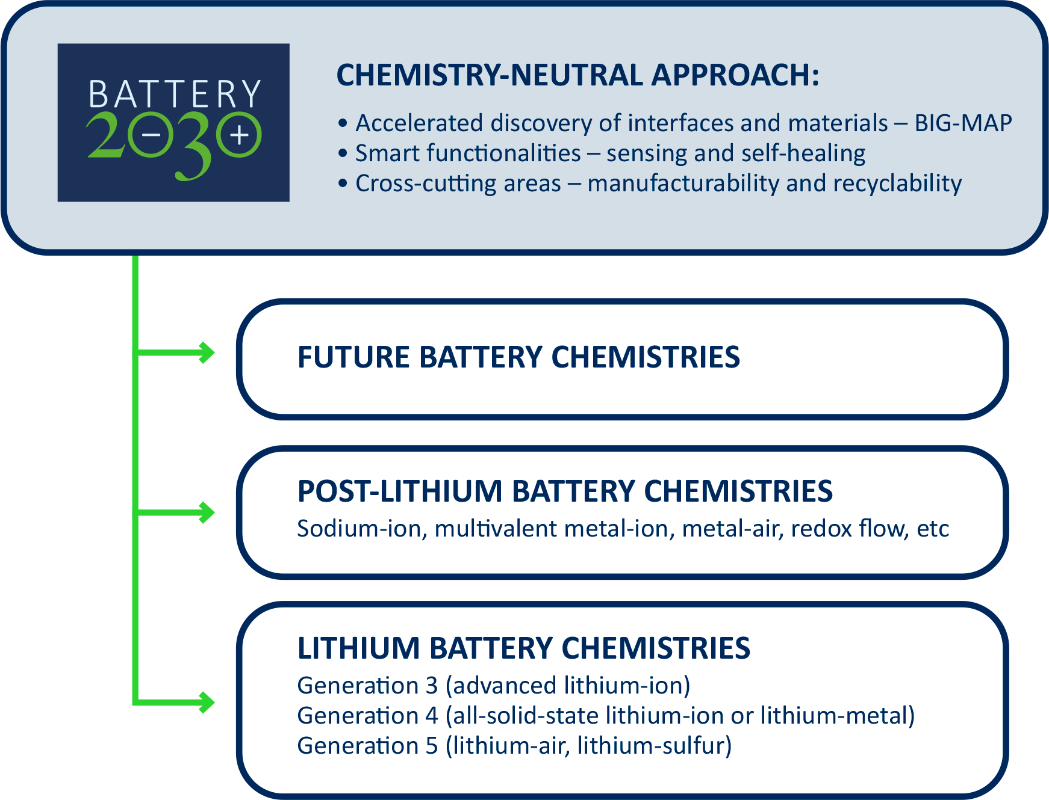
What we need to include!
Batteries for all purposes

Slide 4
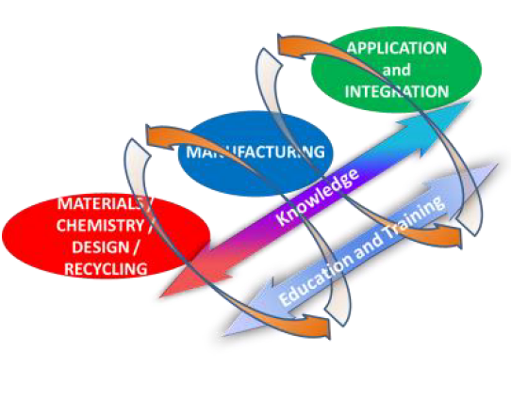
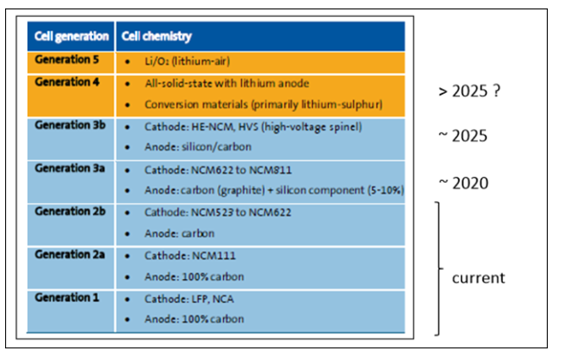
The European SET-Plan action 7

Slide 5
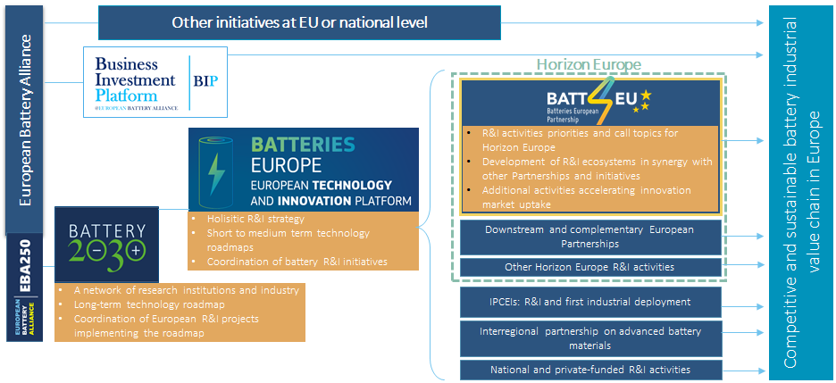
The battery R&I landscape in Europe

Slide 6
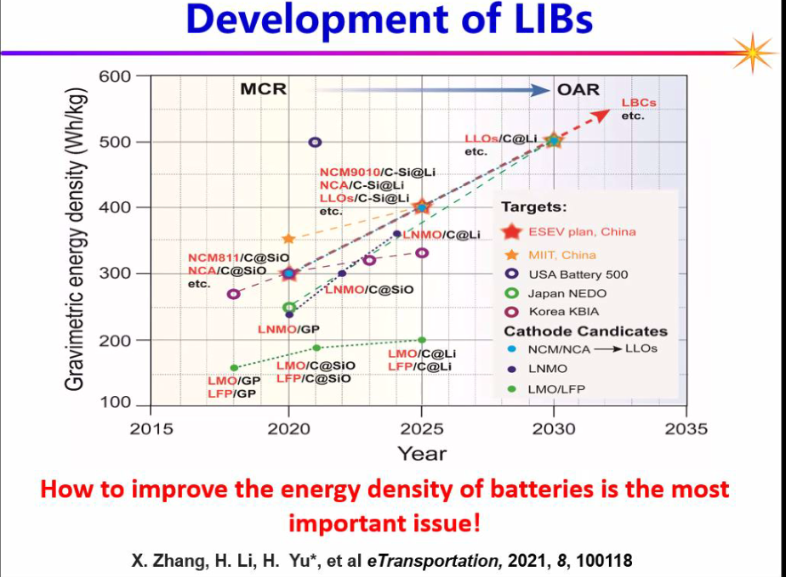

Slide 7



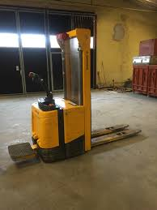
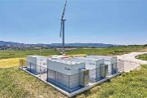


When?
Future
2025-2030
Metal sulfur
Tomorrow
Metal air
Today
Solid state lithium
Lead
Nickel
Sodium
Lithium
Next generation lithium-ion
Na-ion
Redox flow
Organic
Aluminium
Zn-air
Calcium
Magnesium

Slide 8
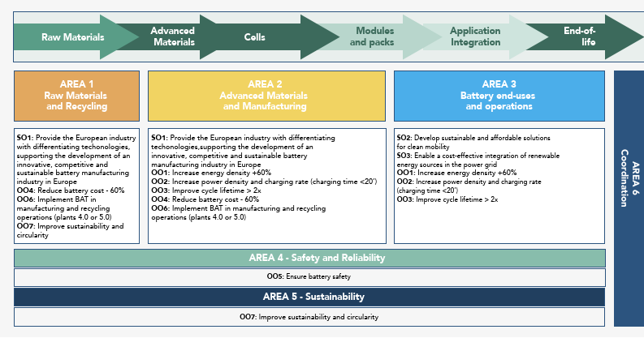
BATT4EU Strategic research agenda (EU battery partnership)

Slide 9
Batteries Europe and roadmaps
2021 6 Roadmaps covering Battery value chain
New and Emerging Battery Technologies
Batteries Raw Materials & Recycling x 2
Advance Materials for Batteries
Battery Cell Design & Manufacturing
Mobility Applications
Stationary Applications
2021 Position Papers
Education & Skills
Sustainability
Safety
Digitalization

Slide 10
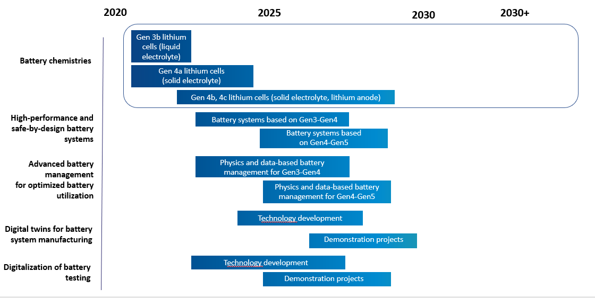
R&I Needs for Integration of Batteries for Mobility
WG 5 Batteries Europe
"One of the main advantages of batteries is the very high energy efficiency of battery electric transportation modes… "
Extract from Batteries Europe WG5 Roadmap 2021

Slide 11
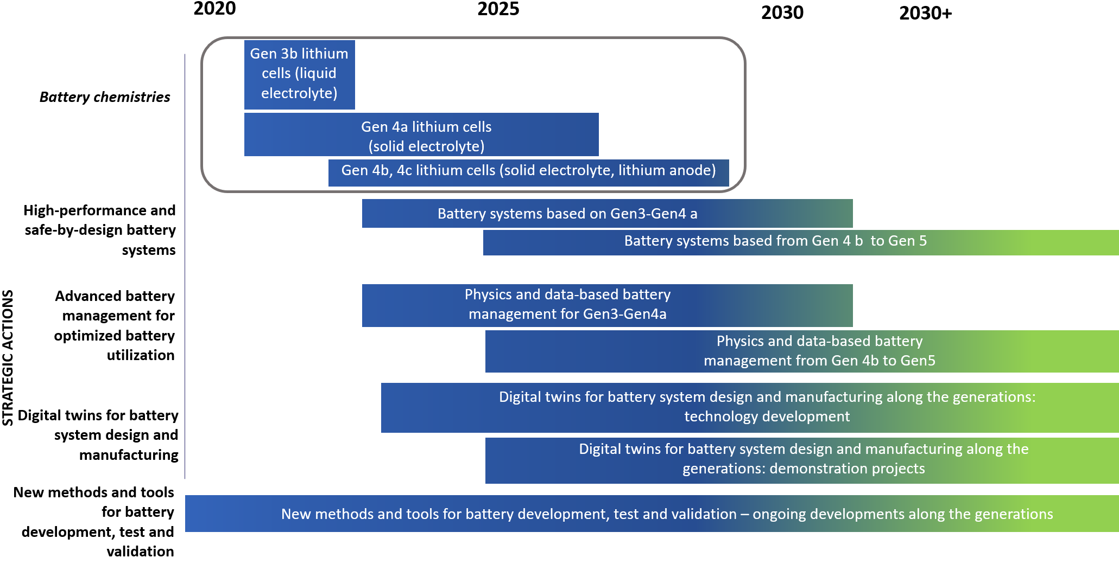
R&I Needs for Integration of Batteries for Mobility
Extract from Batteries Europe WG5 Roadmap 2021

Slide 12
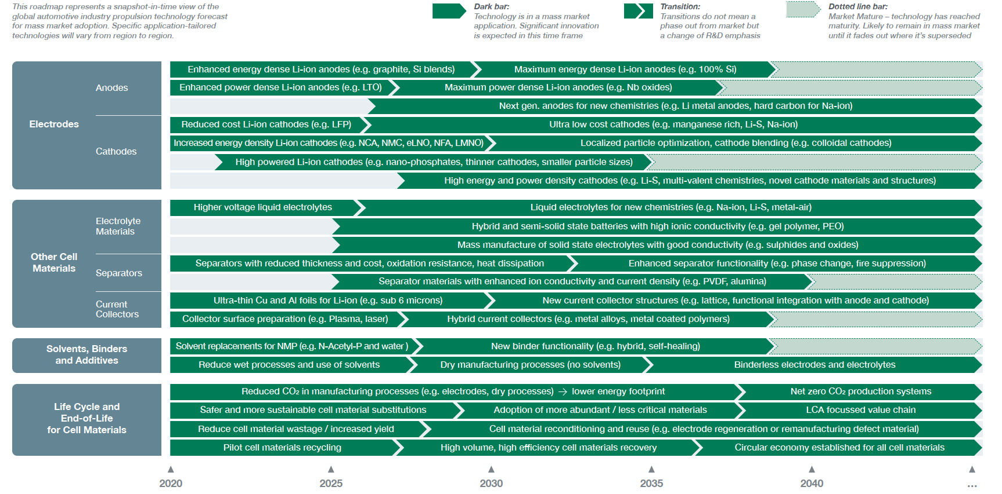
https://www.apcuk.co.uk/app/uploads/2021/09/Technology-Roadmap-Electrical-Energy-Storage.pdf

Slide 13
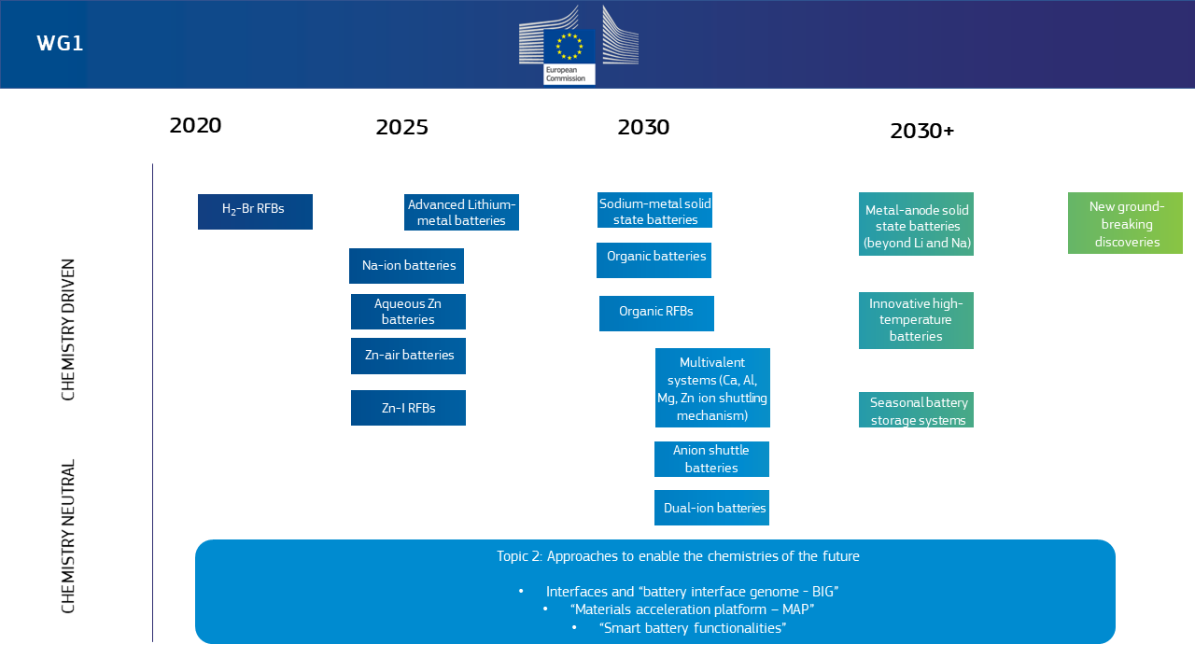
Some highlights
New and emerging
battery technologies

Slide 15


Roadmap – longer than 10 year perspective
www.battery2030.eu
European batteries fit for purpose
Develop theoretical and experimental platforms and tools
Integration of the different parts
Materials accelerating platform + smart battery functionalities
Short term:
Medium term:
Long-term:
Six new projects start 1st of September 2020 + BATTERY 2030+ CSA
New R&I actions suggested now
Our dream!
We work for it with your help!
Vegge, Tarascon, Edström, Advanced Energy Materials, doi:10.1002/aenm.202100362 (2021)

Slide 16
BIG-MAP: Battery Interface Genome Materials Acceleration Platform
Developing an AI-accelerated infrastructure for the European Battery Community: www.big-map.eu
Vision: A modular and chemistry neutral platform for 5-10x accelerated closed-loop discovery using AI-accelerated models & procedures
This project has received funding from the European Union’s Horizon 2020 research and innovation programme under grant agreement No 957189

Slide 17
BIG: Understanding & Controlling Interfaces
Interfaces and interphases play a critical role in all battery technologies
Develop hybrid physics and data-driven models for accelerated discovery
Horstmann, Single, Latz, Current Opinion in Electrochemistry 13, 61-69 (2019)
This project has received funding from the European Union’s Horizon 2020 research and innovation programme under grant agreement No 957189

Slide 18
MAP: An AI-orchestrated Discovery Process
Mission: Enabling autonomous data acquisition, analysis, prediction and utilization
This project has received funding from the European Union’s Horizon 2020 research and innovation programme under grant agreement No 957189

Slide 19
Autonomous Materials discovery
BIG-MAP GOALS to be achieved by 2023
A shared FAIR data-infrastructure spanning research data, simulation codes, scales, experiments and domains using a common ontology (BattINFO)
Developing and sharing externalizable tools, apps and autonomous workflows in the BIG-MAP App Store for the European battery community

Slide 20



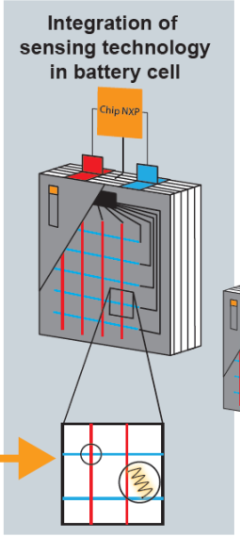
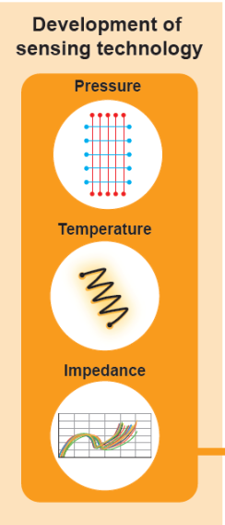
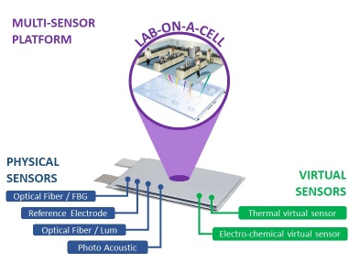
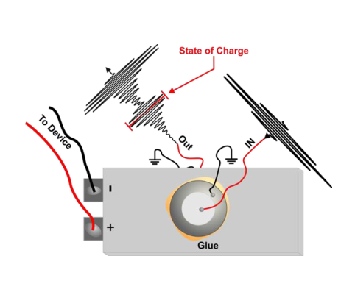
SENSING
Sensing GOALS to be achieved by 2023
Deploy sensors capable of detecting various relevant phenomena (e.g., interface dynamics, electrolyte degradation, dendritic growth, metal dissolution, and materials structure change)
Apply non-invasive multi-sensing approaches transparent to the battery chemical environment offering spatial and temporal resolution
Integrating sensors into existing battery components (e.g., separator, current collector, and electrode composite)
Develops sensors to meet this goal
Optical fibre sensors
Acoustic sensors
Multi-sensor platform: sensors directly in the cell
The SoX Measurement of mechanical,
acoustic, thermal and electrochemical properties

Slide 21

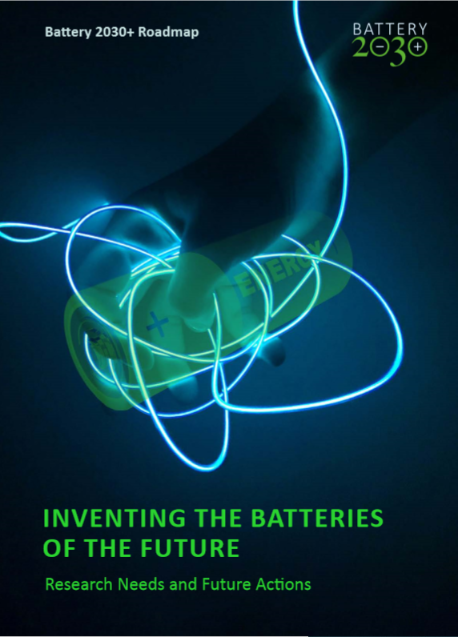
battery 2030+
We create and implement a BATTERY 2030+ research roadmap for a large-scale and long-term initiative
We support Europe to reach the sustainability goals
We develop European research excellence to the benefit of European battery industry, along the full battery value chain
We suggest new R&I actions
We develop curricula
www.battery2030.eu

Slide 22
The battery R&I landscape in Europe

Slide 23


Thank you

